Slide 1
Initial Thesis Presentation
Damien DiGiovine

Slide 2
Research Question
How do mergers and acquisitions affect drug acquisition costs within the (plasma derivatives?) market?
Not 100% sure that this is the market I want to investigate but it is my current leading option

Slide 3
Why Should We Care?
Products are used to save lives and treat disease
Could use data on price changes related to mergers to serve as base for financial policy
Very small section of overall pharmaceutical space
Could serve to uncover specifics of how changes of competitive landscape affect this class not investigated before

Slide 4
Why Isn’t It Obvious?
Mergers and acquisitions can have multiple different effects on pricing in a market
Synergies
Combining two companies can create efficiencies in product production
Potentially decrease prices
Market share
If major producers of a product merge together, they can collect a large share of the overall market
Less competitive pressure
More freedom to set (and potentially increase) prices

Slide 5
Lit Review
Conti and Berndt (2014) - Investigate patent expirations and generic entry into the market. Conclude that the effect of a patent expiration drastically decreases the price to obtain a drug; however, the brand name drug increases slightly in price due to brand loyalty.
Granlund and Bergman (2018) - Use a swedish case study to address the topic of competition in between brand name and generic drugs. Find that as more generic drugs enter market, generic prices drop drastically while brand name prices drop much less significantly.

Slide 6
Lit Review ctd.
Bonaimé and Wang (2024) - Investigate net effect of mergers in pharma. Use regressions and diff-in-diff to conclude that the net effect of mergers in the industry cause price increases.
Gagnon and Volesky (2017) - Track data on historical mergers in pharmaceutical from 1990s to 2016. Find drastic increases in the number and value of mergers across that time period.

Slide 7
Data Sources - Pharmaceuticals
Drug pricing data
Medicaid National Average Drug Acquisition Cost (NADAC)
Contains NDC code, name, acquisition cost, date, and more
Pricing data is taken weekly from 2013 through 2024
14.4 million observations
Drug classifications
FDA Drug Code Directory
Different drug classifications for each NDC code
Pharma classes which are even more detailed

Slide 8
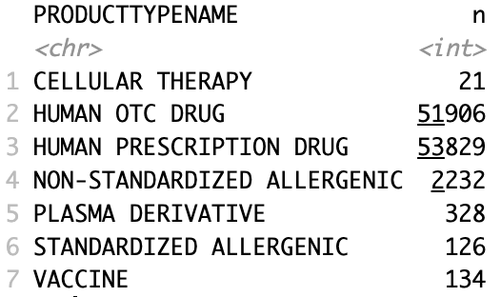

Slide 9
Data Sources (Mergers)
Merger data
Government data
FTC merger enforcement action database
Private data
Nexis Uni (access through Bates)
Mergerstat M&A data
Can keyword search for intended market and look at merger reports from related companies

Slide 10
Potential Methodologies
Diff-in-diff
Treatment - merger in specific pharma class under plasma derivatives
Control - merger in an unrelated pharma class also under plasma derivatives
OLS regression
Dependant - drug acquisition cost
Independant - merger activity

Slide 11
Intended Contribution
A lot of research already done in the field of health economics
Would like to contribute by investigating properties of a specific drug class that has yet to be explored in detail
Want to be able to detail why work within this field is important
How does it affect common people?
Does it disproportionately affect one group over another?
How does it affect companies?
Profit, R&D, innovation, etc.

Slide 12
Expected Results
Increase in number/size of mergers in the space will lead to increases in acquisition price
Small space
Mergers could have a larger effect on market share than in larger space
Less available substitutes than in larger markets

Slide 13
Resources
Bonaimé, Alice, and Ye Wang. “Mergers, Product Prices, and Innovation: Evidence from the Pharmaceutical Industry.” The Journal of Finance (New York) 79, no. 3 (2024): 2195–2236. https://doi.org/10.1111/jofi.13321.
Conti, Rena M., and Ernst R. Berndt. “Specialty Drug Prices and Utilization after Loss of U.S. Patent Exclusivity, 2001-2007.” Working Paper. Working Paper Series. National Bureau of Economic Research, March 2014. https://doi.org/10.3386/w20016.
Granlund, David, and Mats A. Bergman. “Price Competition in Pharmaceuticals – Evidence from 1303 Swedish Markets.” Journal of Health Economics 61 (September 1, 2018): 1–12. https://doi.org/10.1016/j.jhealeco.2018.06.009.
Gagnon, Marc-André, and Karena D. Volesky. “Merger Mania: Mergers and Acquisitions in the Generic Drug Sector from 1995 to 2016.” Globalization and Health 13, no. 1 (August 22, 2017): 62. https://doi.org/10.1186/s12992-017-0285-x.

Slide 14
Any Questions?

